Slide 1


NoisyBoy
Mute the Chaos, Amplify the Serenity

Slide 2

Why Noise Pollution?
Here are some of the detrimental effects of Noise Pollution
Stress and Anxiety
Sleep Disturbances
Economic Impacts
Cognitive Impairment
Hearing Damage
Increased Risk of Accidents
Noise pollution, often being overlooked and quietly infiltrating our lives, silently compromises our well-being and quality of life, making it a forgotten but prevalent pollution.
Our mission is to raise awareness about noise pollution, emphasizing its impact on our health and the economy.
By bringing noise pollution to the forefront, we aim to spark an innovative path towards a harmonious future, underscored by our development of a pioneering product to combat this challenge.

Slide 3

Unpacking the HUMAN Toll of Noise Pollution
Human Health: Excessive noise pollution is associated with a range of negative health effects, including increased stress levels, sleep disturbances, cardiovascular problems, and cognitive impairment.
Quality of Life: High noise levels in urban and residential areas can significantly reduce the quality of life for residents. Constant noise disrupts peace and tranquility, leading to discomfort and dissatisfaction among people living in noisy environments.
Sleep Patterns: Noise pollution disturbs sleep, leading to sleep deprivation, which can result in fatigue, reduced cognitive functioning, and an increased risk of accidents and health problems.

Slide 4

Unpacking the ENVIRONMENTAL Toll of Noise Pollution
Quieting the Noise, Not the Wallet: Noise pollution can lead to higher energy consumption as individuals and businesses attempt to mitigate noise through air conditioning and heating systems, disrupting both our finances and eco-harmony by contributing to increased energy bills and greater carbon emissions.
Noisy Transport: Wasted Energy, Disturbed Efficiency Loud transport not only disrupts communities but also burns energy and resources inefficiently, creating a double impact on both our daily lives and environmental well-being.
Ecosystems:
Noise pollution disrupts natural ecosystems by altering wildlife behaviour, causing stress in animals, and interfering with their ability to communicate and find food. This can lead to reduced biodiversity and disrupted ecological balance. Sustainable living involves respecting and preserving biodiversity, and noise pollution can hinder those efforts.

Slide 5
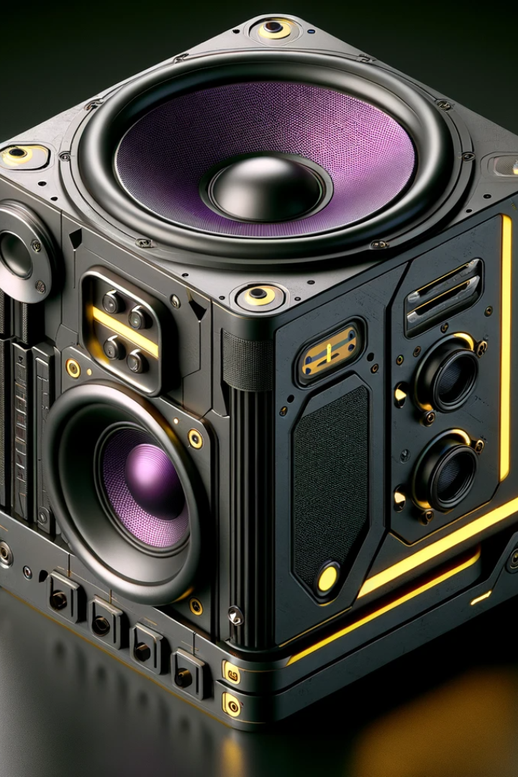
NoisyBoy
The Gateway to Uninterrupted Bliss in a Noisy World!
Noisy Boy isn't just a device; it's your secret weapon against disruptions.
Simply attach it onto anything that disrupts your peace — be it a noisy construction machine, the roaring engine of a plane, or the relentless hum of tire noise in your car. With Noisy Boy, silence becomes your ally, giving you the power to continue your day undisturbed.

Slide 6

Use-Case Scenarios

Slide 7

Construction Sites
Noisy Boy transforms the construction environment into a more tolerable and safer workspace.
It allows workers to focus on tasks without the distraction of loud machinery, improving overall productivity and safety on the site.

Slide 8

Flights
Noisy Boy provides an oasis of calm in the skies. Whether you're working, relaxing, or trying to catch some sleep, the noise cancellation technology ensures a quieter and more comfortable flying experience, reducing travel-related stress.

Slide 9

Road Noise in Cars
Noisy Boy transforms your car into a serene, noise-free zone. Enjoy peaceful drives, clearer communication with passengers, and an overall improved driving experience. It adds an extra layer of comfort for both short commutes and long road trips.

Slide 10
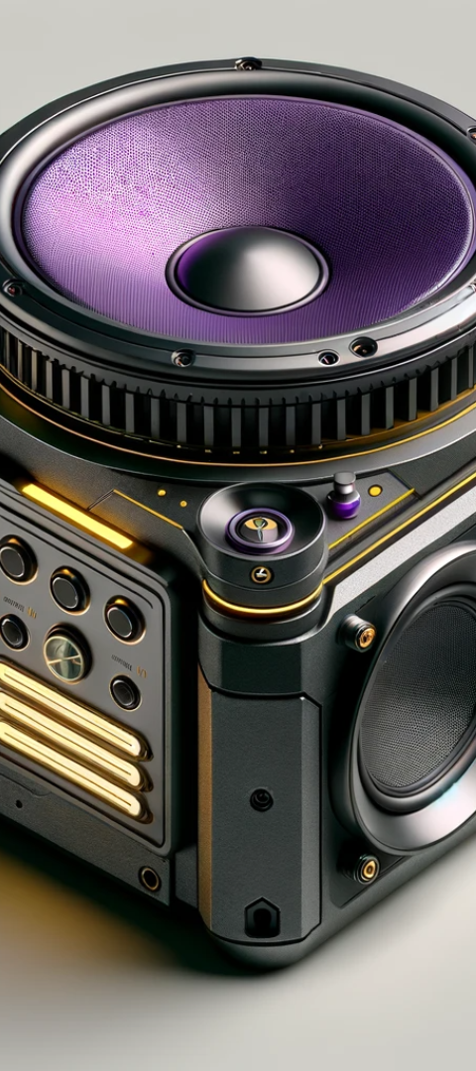
How NoisyBoy works:
1
Precision: Frequency Analysis
NoisyBoy utilizes a built-in microphone system to analyze frequencies, with a focus on identifying harsh sounds, especially from sources like construction sites.
2
Advanced Frequency Transformation
Upon detection, NoisyBoy transforms the identified harsh frequencies into precise opposites, a key step in neutralizing unwanted noise.
3
Opposite Frequency Emission
Equipped with high-fidelity speakers, NoisyBoy emits the synthesized opposite frequencies, strategically canceling out the original disruptive sounds and creating a quieter environment.

Slide 11
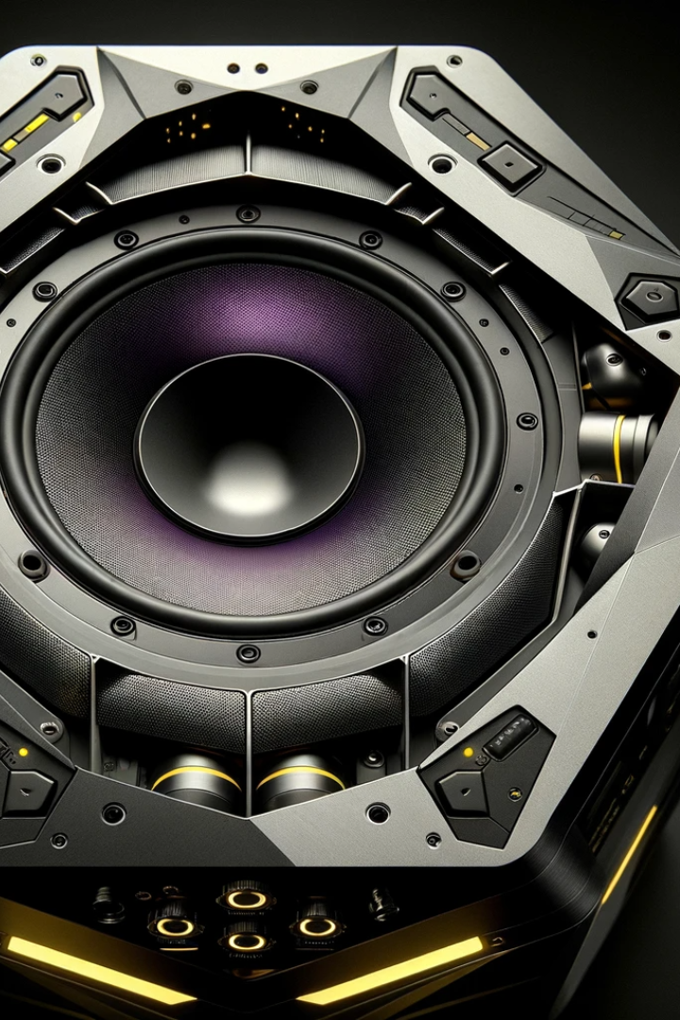
Why NoisyBoy?
1
Reduced Impact on Ecosystems:
2
Enhanced Quality of Life:
By lowering noise levels, ecosystems can return to a more natural state, contributing to biodiversity and ecological balance.
Lower noise levels in urban areas and residential neighborhoods can lead to a higher quality of life. People can enjoy a quieter environment, leading to better mental health and improved overall satisfaction with their living conditions.
3
Improved Human Health:
By reducing noise pollution, the overall health and well-being of individuals can be improved, leading to reduced healthcare costs and a healthier, more productive workforce.

Slide 12

Next Steps
1
Eco-Materials and Lifecycle Design:
2
Energy Efficiency and User Awareness:
Prioritize sustainable materials like recycled plastics or biodegradable composites.
Optimize the device for energy efficiency during use.
Educate users on sustainable practices, from proper usage to end-of-life disposal, promoting a holistic approach to sustainability.
Implement a modular and easily recyclable design for a reduced environmental footprint.

Slide 13
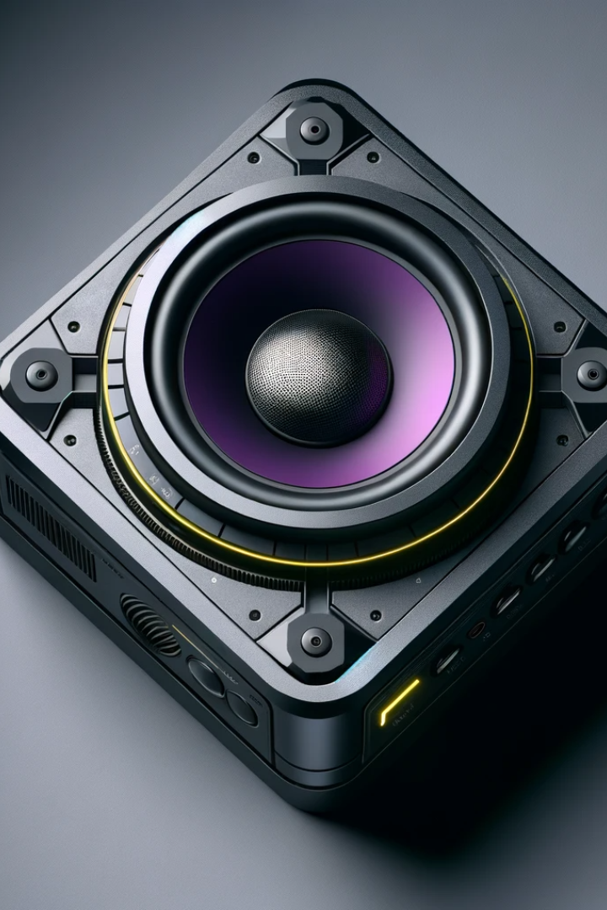
Harmony in Silence:
A Sustainable Noise-Proof Future
1
Our Pledge:
Committed to eco-friendly practices in design and production.
A promise of continuous improvement in sustainability.
2
Join the Symphony:
Embrace the silent revolution for a sustainable tomorrow.
Together, let's make every moment harmonious and eco-conscious.
3
Your Sound, Our Planet:
This isn't just a device; it's a statement for sustainable living.
Your choice matters — for you, for us, for our planet.
Thank you for being part of the quiet revolution towards a more sustainable
and harmonious world.
You can learn more about us on https://noisyboy.netlify.app

